Slide 1
Animal-Outages

Slide 2
Literature
Animal outages:
Have seasonal patterns (animal behavior, weather)
Are largely squirrel caused, but birds are the next biggest group
Factors involved in bird-related outages:
Environmental: habitat, spatial location, weather
Biological: traits (behavior, morphology)
Electrical structure/engineering design
Bird-caused outages have implications for species and utility managers.
Data:
Records of animal outages, bird mortality studies, vegetation and weather data
Notes:
Controlling for additional factors

Slide 3
Research gap:
Rarely use direct measures of animal abundance (hard to obtain at fine resolutions)
Finest resolution application has been seasonal abundance over 2 years at coarse spatial resolution (Maliszewski et al 2012)
Direct causes of bird related outages are well studied, but few address the likelihood of disruption given a range of bird population characteristics.
Species specific grid interactions are not addressed in larger scale modeling studies (limited to mortality studies).

Slide 4
Our research aim
To infer characteristics of bird populations (species type, trends in abundance, and spatial distributions) that negatively impact the reliability of the grid in Massachusetts.
Temporal patterns: do relationships between bird abundances and outages vary by season? Do outage events increase with bird abundance?
Spatial patterns: do towns with higher bird abundances have more outages/disruption?
Novel contributions:
We study the relationship between birds and outages at finer spatial and temporal resolutions (monthly, town resolution) and use a direct measure of bird activity (abundance) as opposed to inferring activity from outage records.
We use species with high outage risk (identified in bird mortality studies) as separate variables to account for differing interactions with the grid.

Slide 5
Data
Study area and time scale: Massachusetts 2013-2018
Outages: Animal-caused (non-squirrel), weekly town resolution
Metrics: Outage frequency (# of outages, measure of direct bird impact), COH (Number of customers*Duration, measure of distribution reliability)
Bird Abundance: weekly landscape estimates, aggregated to mean monthly town resolution
Metrics: Encounter rate- Probability of detecting a species on a survey
Raptors: Red-tailed hawk (RTHA), Osprey (OSPR), Turkey vulture (TUVU)
Blackbirds: Red-winged blackbird (RWBL), Common Grackle (COGR), Brown-headed cowbird (BHCO)
Woodpeckers: Red-bellied woodpecker (RBWO), Downy woodpecker (DOWO), Hairy Woodpecker (HAWO), Pileated woodpecker (PIWO), Northern flicker (NOFL)
Urban generalists: European starling (EUST), House sparrow (HOSP), Rock pigeon (ROPI)
Corvids: American crow (AMCR)
Notes:
What measure of abundance best relates to outages? Aggregate previous 4 weeks? Lag data, use cross correlation?

Slide 6
Data Cont…
Land cover: proportion of urban development, forest, open habitat, wetland in each town
NLCD 2016
Minimum temperature: weekly, town resolution
PRISM Climate Group
Human population density: population / town area
2010 census

Slide 7
Do spatial and temporal patterns in bird abundance correspond with patterns in animal outages?

Slide 8
Temporal Patterns
Do seasonal trends in outages and abundance overlap? Looking at time series?
Do extreme/anomalous events correlate between outages and abundance?
Temporal anomalies- ((T_i – T_i_yrly_avg)/T_i_yrly_stdev) deviation from the monthly/weekly average across years for each town.
Removes seasonal trends from both datasets.
Standardizes outage and abundance values, identifies above/below average events.
Town values are no longer relative. Points in time are relative.
Focus on specific towns to assess this relationship.
Use correlation or regression of anomalies over time.
OutageAnomaly ~ town + SpeciesAnomaly_1 ... + SpeciesAnomaly_n + LandcoverType + HumanDensity+MinimumTemp

Slide 9
Temporal Patterns
Do seasonal trends in outages and abundance overlap? Looking at time series?
Do extreme/anomalous events correlate between outages and abundance?
Temporal anomalies- ((T_i – T_i_yrly_avg)/T_i_yrly_stdev) deviation from the monthly/weekly average across years for each town.
Removes seasonal trends from both datasets.
Standardizes outage and abundance values, identifies above/below average events.
Town values are no longer relative. Points in time are relative.
Focus on specific towns to assess this relationship.
Use correlation or regression of anomalies over time.
OutageAnomaly ~ town + SpeciesAnomaly_1 ... + SpeciesAnomaly_n + LandcoverType + HumanDensity+MinimumTemp

Slide 10
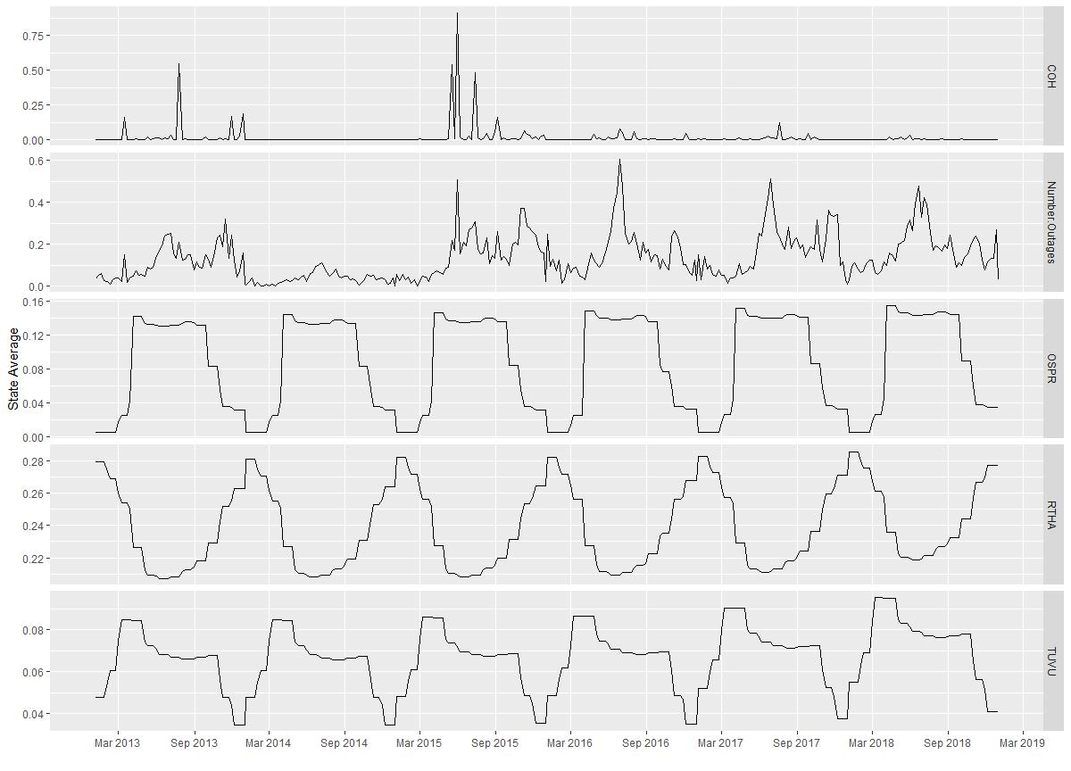
Seasonal Patterns
Animal outages are most frequent in June and November (late spring and fall). Least frequent in Jan-March (Winter).
Northern flicker, Osprey, Turkey Vulture, Common Grackle, and Brown-headed cowbird are most similar to these seasonal patterns

Slide 11
Temporal Patterns
Do seasonal trends in outages and abundance overlap? Looking at time series?
Do extreme/anomalous events correlate between outages and abundance?
Temporal anomalies- ((T_i – T_i_yrly_avg)/T_i_yrly_stdev) deviation from the monthly/weekly average across years for each town.
Removes seasonal trends from both datasets.
Standardizes outage and abundance values, identifies above/below average events.
Town values are no longer relative. Points in time are relative.
Focus on specific towns to assess this relationship.
Use correlation or regression of anomalies over time.
OutageAnomaly ~ town + SpeciesAnomaly_1 ... + SpeciesAnomaly_n + LandcoverType + HumanDensity+MinimumTemp

Slide 12
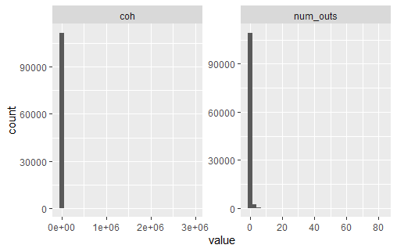
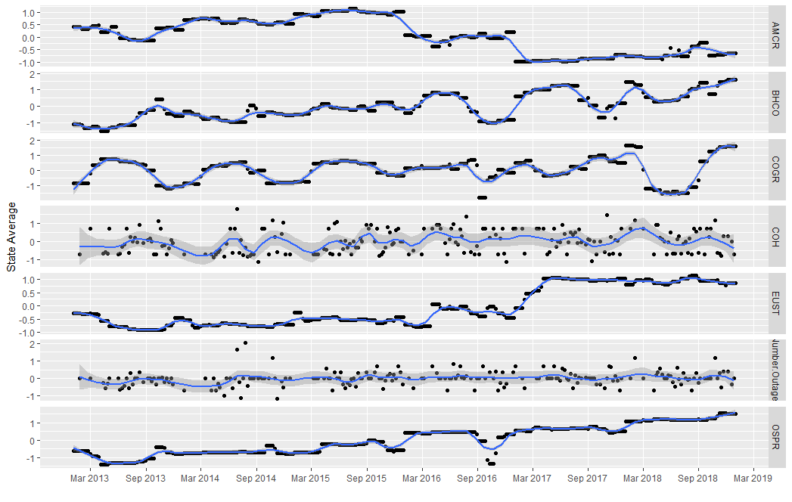
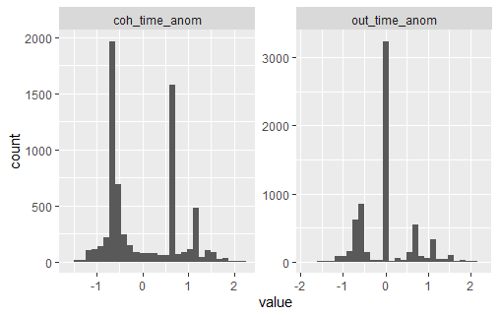
Temporal Anomalies
Rescaled/standardized all data
Normalized the data distributions

Slide 13
Spatial Patterns
Do towns with higher bird abundance have more animal outages?
Spatial anomalies- ((town - state average)/state stdev) deviation relative to other towns in the same weekly time step.
Calculate moving window of correlations between outages and abundance across towns at each weekly time step. Plot correlations over time. Are there specific events in time where birds explain outages more than others?
Regression: towns as subjects, weeks as replicates
OutageAnomaly ~ season + year + speciesAnomaly_1 … + speciesAnomaly_n + landcoverType + Human Density + MinimumTemp

Slide 14
Spatial Patterns
Do towns with higher bird abundance have more animal outages?
Spatial anomalies- ((town - state average)/state stdev) deviation relative to other towns in the same weekly time step.
Calculate moving window of correlations between outages and abundance across towns at each weekly time step. Plot correlations over time. Are there specific events in time where birds explain outages more than others?
Regression: towns as subjects, weeks as replicates
OutageAnomaly ~ season + year + speciesAnomaly_1 … + speciesAnomaly_n + landcoverType + Human Density + MinimumTemp

Slide 15
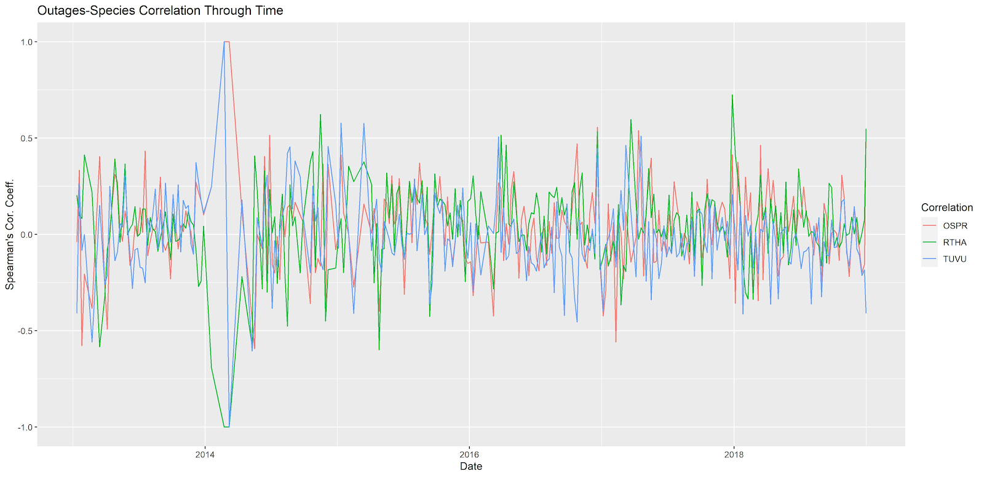
Spatial Patterns
Distribution of high bird abundance corresponds to distribution of high outage events. This relationship fluctuates through time.

Slide 16
Species specific effects
Do specific species have different relationships with outages?
PCA or factor analysis
Identify groups of towns/weeks with distinct species compositions. Create biplots of these weekly/town events and see where extreme outage events fall within these species compositions.
Multiple Quantile Regression:
Does bird abundance explain outages at certain levels of severity? Are certain species more associated with extreme outage events? Less extreme?
Account for factors of human population density, land cover types, minimum temperature and season

Slide 17
Species specific effects
Do specific species have different relationships with outages?
PCA or factor analysis
Identify groups of towns/weeks with distinct species compositions. Create biplots of these weekly/town events and see where extreme outage events fall within these species compositions.
Multiple Quantile Regression:
Does bird abundance explain outages at certain levels of severity? Are certain species more associated with extreme outage events? Less extreme?
Account for factors of human population density, land cover types, minimum temperature and season

Slide 18
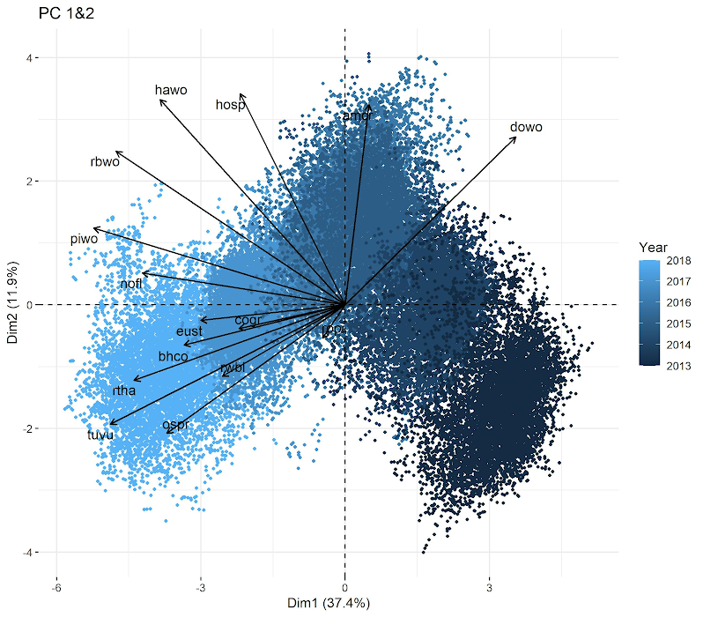
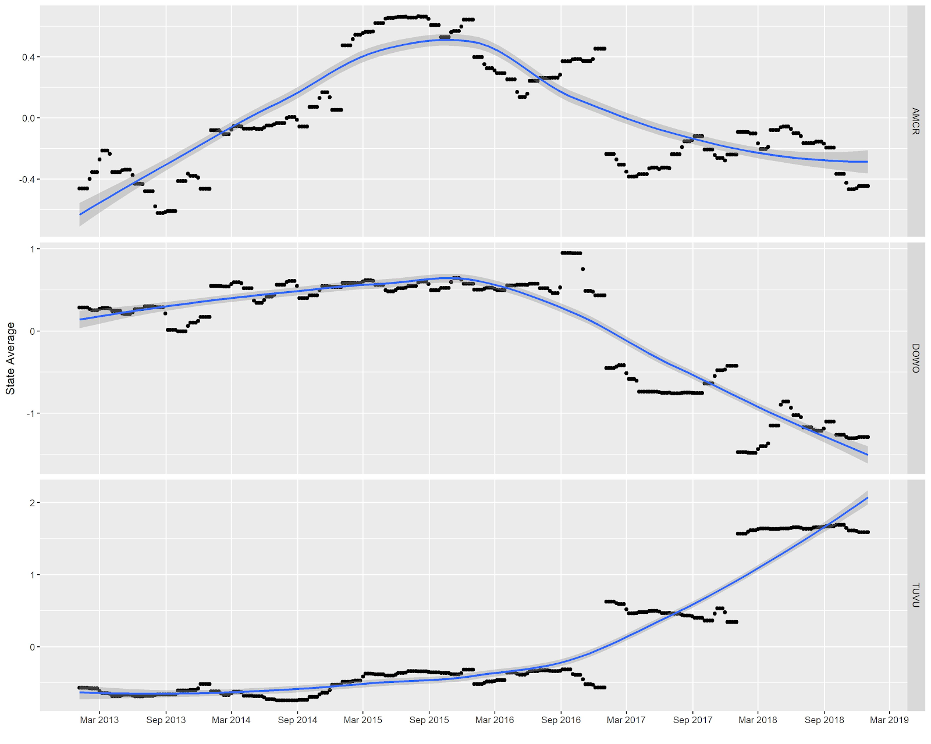
PCA-Temporal Anomalies
city | year | week | rwbl | cogr | bhco | rtha | ospr
ABINGTON | 2013 | 1 | -0.8905 | -1.1656 | -1.11197 | -0.21416 | -0.66943
ABINGTON | 2013 | 2 | -0.8905 | -1.1656 | -1.11197 | -0.21416 | -0.66943
ABINGTON | 2013 | 3 | -0.8905 | -1.1656 | -1.11197 | -0.21416 | -0.66943
ABINGTON | 2013 | 4 | -0.8905 | -1.1656 | -1.11197 | -0.21416 | -0.66943
ABINGTON | 2013 | 5 | -0.4277 | -0.43624 | -0.89912 | -0.24122 | -0.6649
ABINGTON | 2013 | 6 | -0.0806 | 0.110779 | -0.73947 | -0.2615 | -0.6615
ABINGTON | 2013 | 7 | -0.0806 | 0.110779 | -0.73947 | -0.2615 | -0.6615
ABINGTON | 2013 | 8 | -0.0806 | 0.110779 | -0.73947 | -0.2615 | -0.6615
ABINGTON | 2013 | 9 | 0.497049 | 0.768343 | 0.203437 | -0.32614 | -0.65301
ABINGTON | 2013 | 10 | 0.930285 | 1.261517 | 0.91062 | -0.37462 | -0.64665
Input variables: Species temporal anomalies.
Output biplot coordinates: events (towns/weeks) clustered by dates with abundance anomalies in similar species
Notes:
towns clustered in light blue contain species with steadily increasing population trends (their highest temporal anomalies are in 2018). These species include turkey vulture, osprey, redtailed hawk, northern flicker, pileated woodpecker, and brown-headed cowbird. Species in the center of the plot in a medium blue peak in their abundance in the middle of our study period (around 2015-2016, a non-linear trend). They include rock pigeon, house sparrow and american crow. Downy woodpecker populations peaked the earliest in the study period and had lower numbers as time progressed

Slide 19
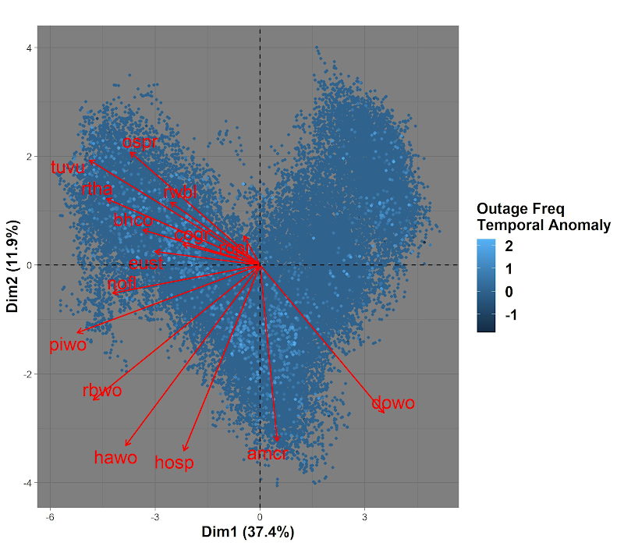
PCA-Temporal Anomalies
city | year | week | rwbl | cogr | bhco | rtha | ospr
ABINGTON | 2013 | 1 | -0.8905 | -1.1656 | -1.11197 | -0.21416 | -0.66943
ABINGTON | 2013 | 2 | -0.8905 | -1.1656 | -1.11197 | -0.21416 | -0.66943
ABINGTON | 2013 | 3 | -0.8905 | -1.1656 | -1.11197 | -0.21416 | -0.66943
ABINGTON | 2013 | 4 | -0.8905 | -1.1656 | -1.11197 | -0.21416 | -0.66943
ABINGTON | 2013 | 5 | -0.4277 | -0.43624 | -0.89912 | -0.24122 | -0.6649
ABINGTON | 2013 | 6 | -0.0806 | 0.110779 | -0.73947 | -0.2615 | -0.6615
ABINGTON | 2013 | 7 | -0.0806 | 0.110779 | -0.73947 | -0.2615 | -0.6615
ABINGTON | 2013 | 8 | -0.0806 | 0.110779 | -0.73947 | -0.2615 | -0.6615
ABINGTON | 2013 | 9 | 0.497049 | 0.768343 | 0.203437 | -0.32614 | -0.65301
ABINGTON | 2013 | 10 | 0.930285 | 1.261517 | 0.91062 | -0.37462 | -0.64665
Outages mostly fall within times with high bird abundance. Doesn’t seem species specific. Abundance and outages increase in later years.
Notes:
towns clustered in light blue contain species with steadily increasing population trends (their highest temporal anomalies are in 2018). These species include turkey vulture, osprey, redtailed hawk, northern flicker, pileated woodpecker, and brown-headed cowbird. Species in the center of the plot in a medium blue peak in their abundance in the middle of our study period (around 2015-2016, a non-linear trend). They include rock pigeon, house sparrow and american crow. Downy woodpecker populations peaked the earliest in the study period and had lower numbers as time progressed

Slide 20
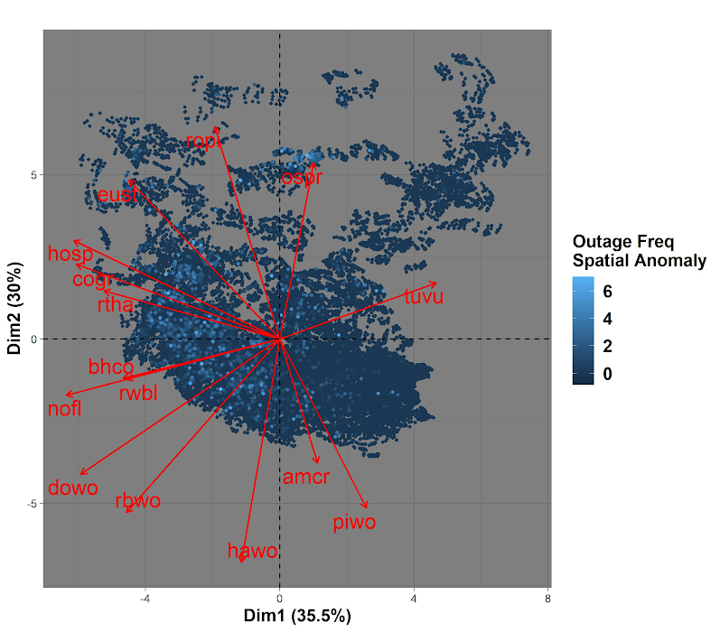
PCA-Spatial Anomalies
Input variables: Species spatial anomalies.
Output biplot coordinates: events (towns/weeks) clustered by towns with similar species compositions
Extreme outages are clustered in towns with high Osprey abundance. Osprey have a unique distribution (coastal), giving them a unique cluster of towns.
Remaining outage events are scattered across towns with widely distributed species such as woodpeckers, blackbirds, and red-tailed hawks.
Outages are less associated with turkey vulture, pileated woodpecker, and American crow distributions

Slide 21
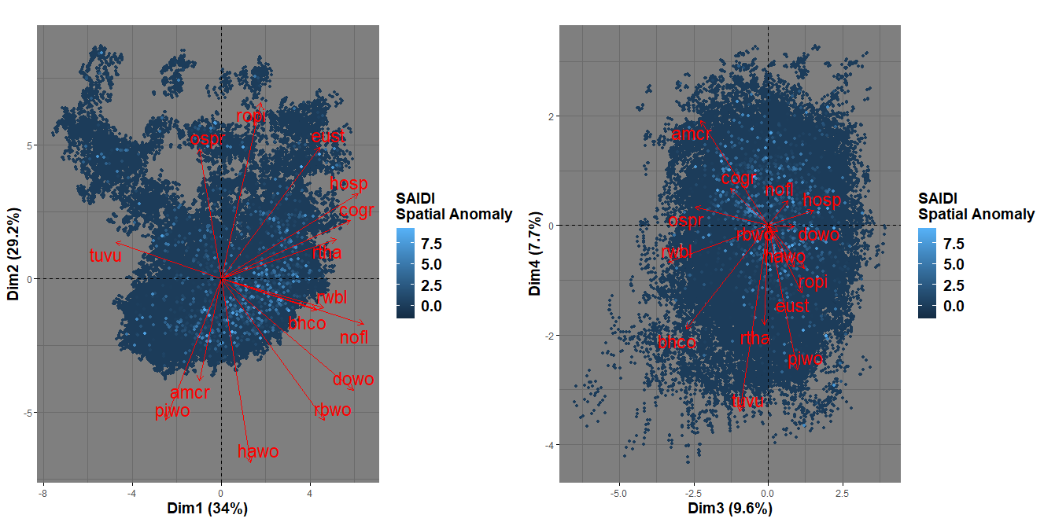
PCA-Spatial Anomalies

Slide 22
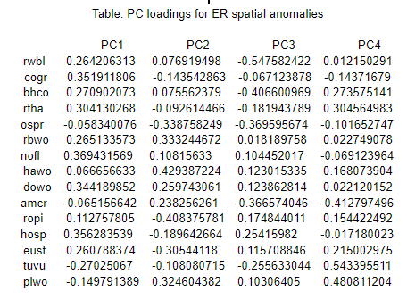
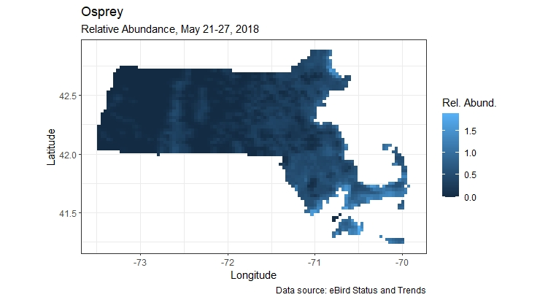
PCA-Spatial Anomalies
First PC places ~equal weights on most species except for turkey vulture and pileated woodpecker.
Outage events are generally occurring in locations with a diverse mix of species.
Osprey is an exception. It occupies a more unique distribution from other species and shows a cluster of outage events within its distribution.
A less reported species for causing outages via electrocution but the pose risks of nest of prey contact with wires

Slide 23
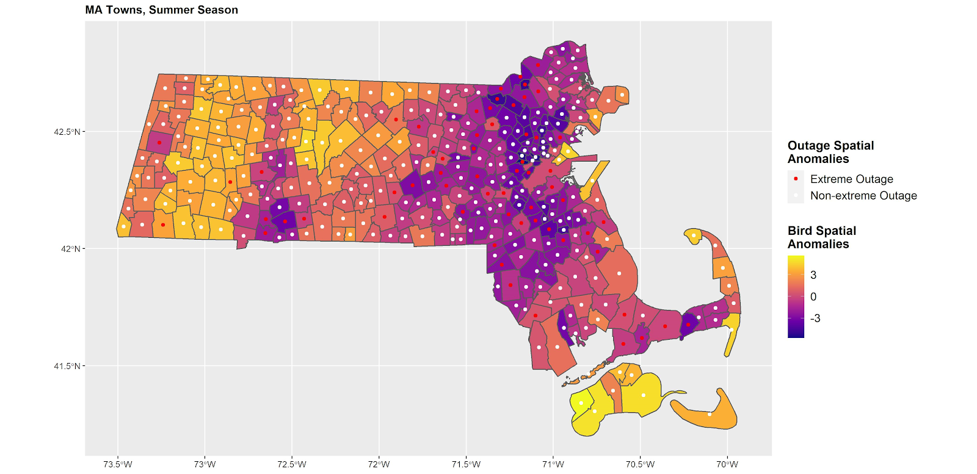
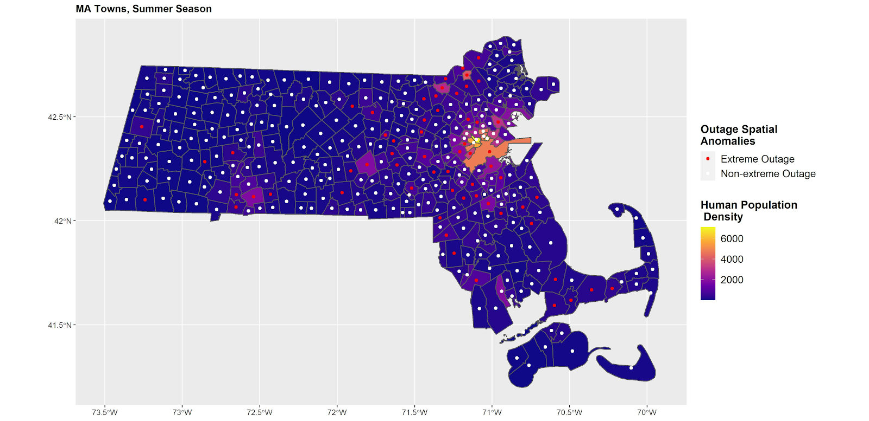
The urban-rural gradient
Towns colored by PC1, distributions of species in summer
Dark blue (negative PC1) indicates distribution of woodpeckers, blackbirds, and urban species. Light yellow (positivePC1) indicates turkey vulture, crow, and osprey distributions. Map values are calculated by averaging each town’s spatial anomaly throughout the summer season.
Similar to urban-rural gradient?

